Slide 1
YouTube Data Analyzer
Sowmya Kudva
Evan Grill

Slide 2

Background
YouTube is the number one video sharing site on the internet.
Over 1 Billion unique visitors each month.
Big audience means big data
All of this data is in unstructured format and can be analyzed with the help of Bigdata frameworks such as MR or Apache Spark
The PageRank algorithm can be applied to YouTube videos to determine the highest quality videos.
300 hours of videos uploaded every minute.

Slide 3
Implementation
Analysis on the Youtube dataset is done using Apache spark .
Performed the data processing locally with the small subset of data.
Perform similar implementation on Amazon's Elastic MapReduce (EMR) Platform.

Slide 4
Steps We Followed
Installed Java, Spark, and PySpark using HomeBrew.
Homebrew is a robust package manager for Mac and Linux (and Windows) operating systems.
Configured environment variables.
Downloaded YouTube dataset.
Create a SparkContext object in code.
Create an RDD from the dataset.
Using data analysis functions (e.g. Map, Reduce, Filter, etc.) develop a workflow to produce desired resulting data.
Output results.

Slide 5
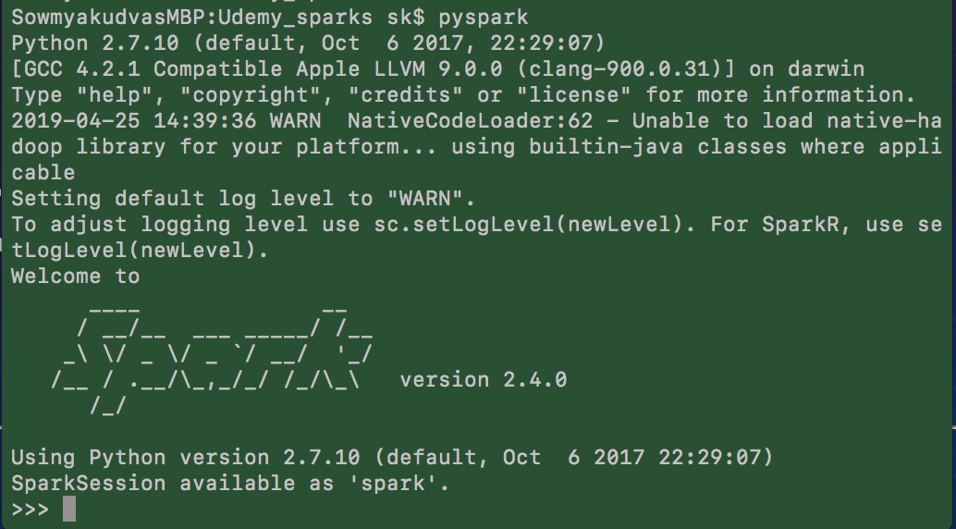
Apache Spark
Apache Spark was built on top of the Apache Hadoop framework.
It extends the MapReduce model to efficiently use it for more type of computations using interactive queries and stream processing.
Resilient Distributed Datasets (RDDs) are the fundamental data structures of Spark.
Spark automatically distributes the data contained in RDDs across cluster and parallelizes the data.
Written in Scala Language
To support Python with Spark, community released a PySpark shell and Python library

Slide 6
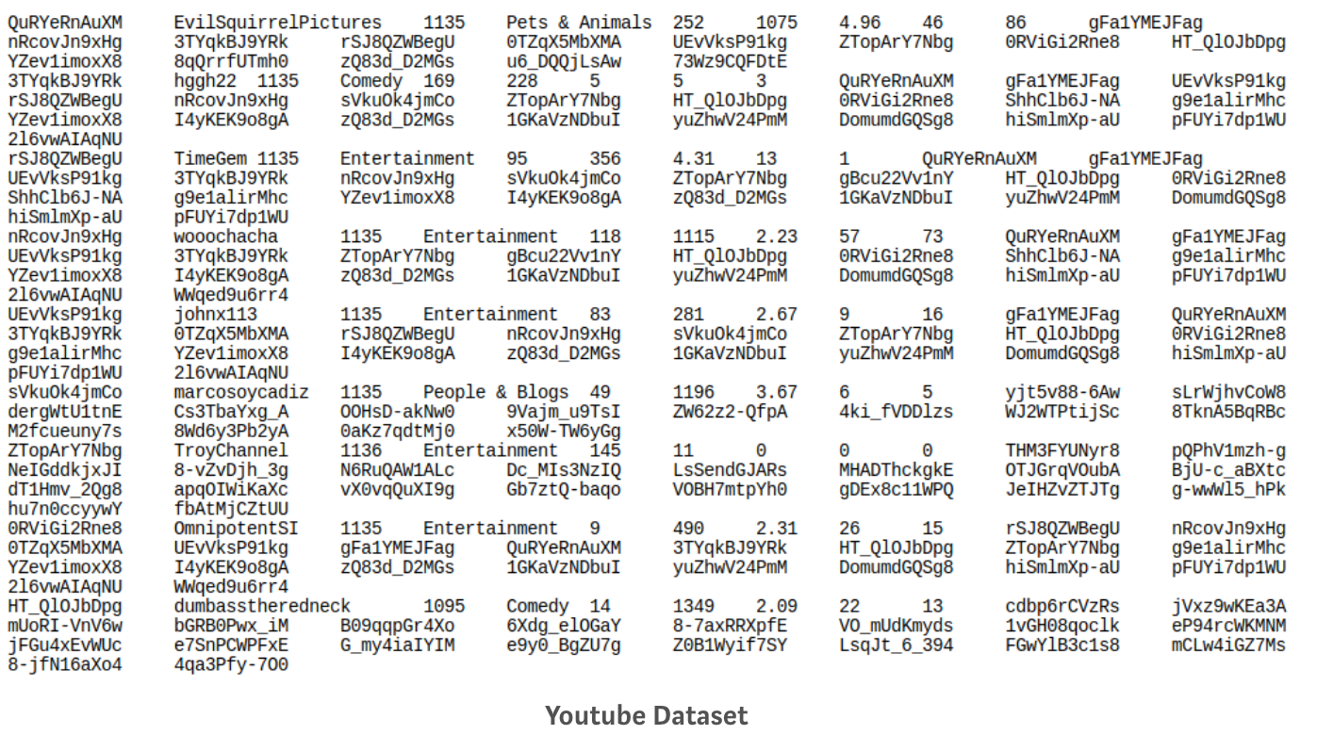
Sample Dataset
The dataset includes a series of scrapes of YouTube data from 2007/2008. It was compiled by researchers at Simon Fraser University. It can be found at http://netsg.cs.sfu.ca/youtubedata/

Slide 7
Understanding The Dataset
Column 1: Video ID
Column 2: Video Uploader (User)
Column 3: Upload Date (Number of days since creation of YouTube)
Column 4: Video Category
Column 5: Video Length (seconds)
Column 6: Number of views for the video.
Column 7: Average Rating
Column 8: Number of Ratings
Column 9: Number of Comments
Column 10-29: Video IDs for 20 Related Videos

Slide 8
Constraints/Issues
Some rows lacked related video IDs.
Some rows lacked any metadata beyond the video ID.
Required preprocessing of data.

Slide 9
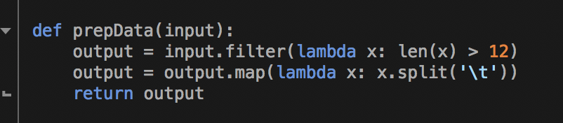
Preprocessing
Using methods built into Spark, the data can be sanitized at runtime.
RDD filter transformation extracts only the rows that satisfy a condition. In our case, the row needed to contain more data than just the video ID.
We also split the line of text into a list of individual columns as part of the prepData function as seen to the left.

Slide 10
Using This Dataset, We Performed Some Analysis And have Drawn Out Some Insights..
Highest Pageranked Video
Top Categories by Number of Videos
Top Videos by Rating (Sorted by number of ratings)
Top Videos by Number of Comments
Top Categories by Number of Views
Top Users by Number of Uploads

Slide 11

Usecase-1 – PageRank of Videos
Each row of the dataset creates a unidirectional graph that becomes a piece of the much larger graph of YouTube data.
Assembling this graph allows for the calculation of the PageRank of individual videos.
PageRank is an iterative algorithm that takes $O(n^{2})$ time per iteration.
The entire dataset is about 8.5 million individual videos. This means, the graph has about 8.5 million vertices and about 170 million edges.
PageRank on the full dataset is a very time consuming endeavor.
Video
…
Related Videos

Slide 12
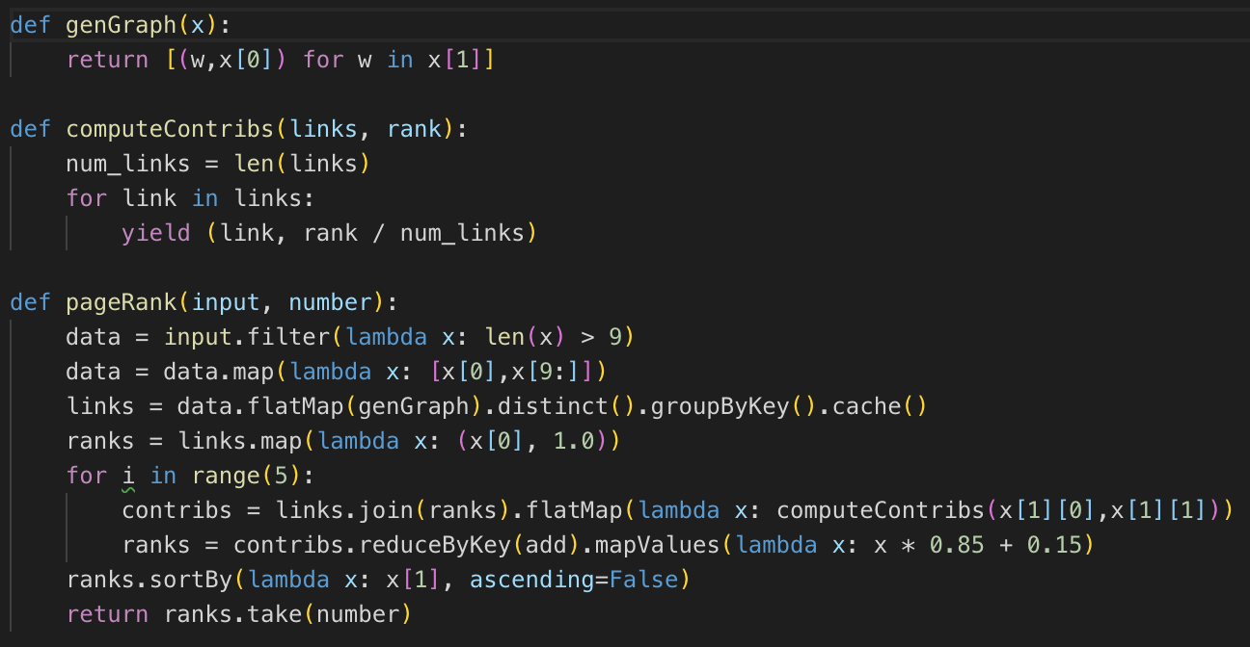
PageRank Implementation
We weren’t able to get Spark to emit different types of tuples from a map operation as required by most implementations.
Luckily, there exists an implementation of PageRank that avoids this trouble.
Algorithm traverses the graph by traversing the edge/vertices list provided by the dataset.
Each iteration, relative PageRank contribution is calculated.
Properly, you would run until you reach a variance threshold (possibly 100+ iterations), but for time purposes we ran 5 iterations.

Slide 13
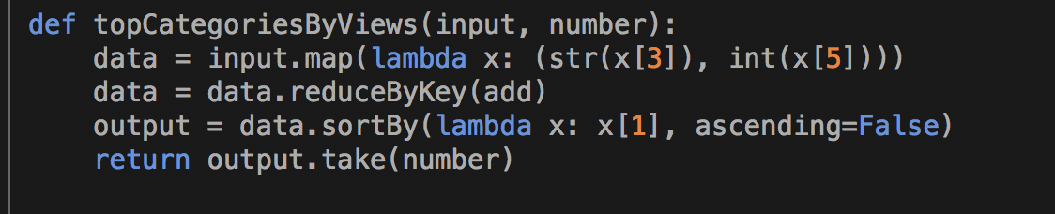
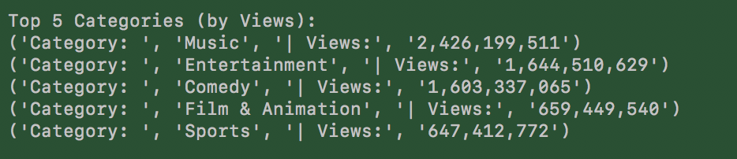
Use Case 2 - Top Categories By Views
Steps:
For each row, map: (row) -> (category, views)
For each tuple, reduce by adding: (category, views) -> (category, total views)
Sort results by views, descending.

Slide 14

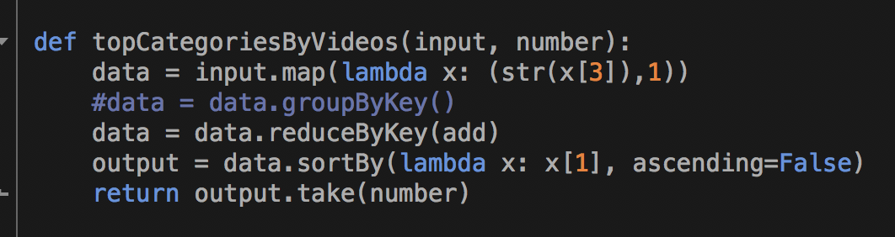
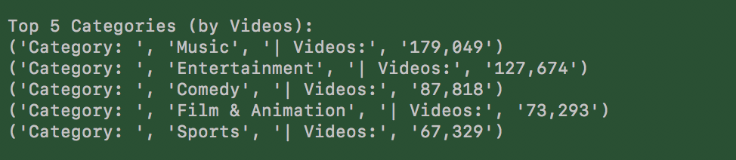
Use Case 3 - Top Categories By Videos
Steps:
For each row, map: (dataset) -> (category, 1)
For each tuple, reduce by adding: (category, 1) -> (category, total number of videos)
Sort by number of videos.

Slide 15
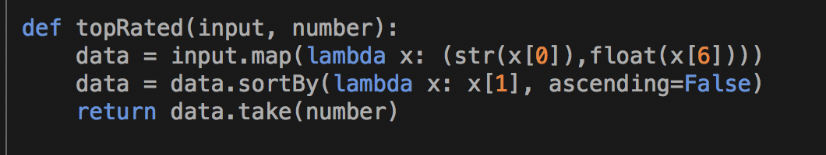
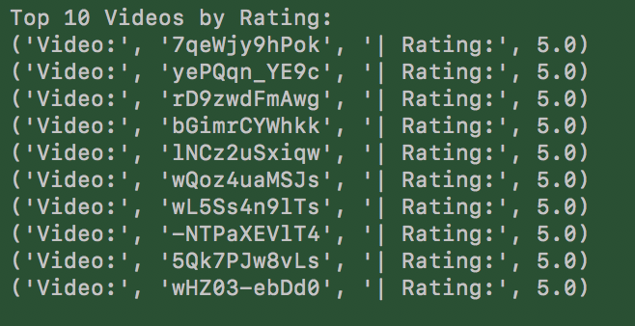
Use Case 4 - Top Highly Rated Videos
Steps:
For each row, map: (dataset) -> (video ID, rating)
Sort by rating.
Later improvements sorted secondarily by number of ratings.

Slide 16
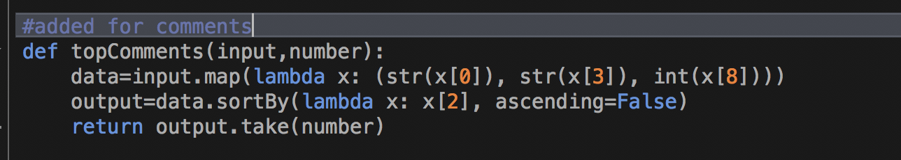
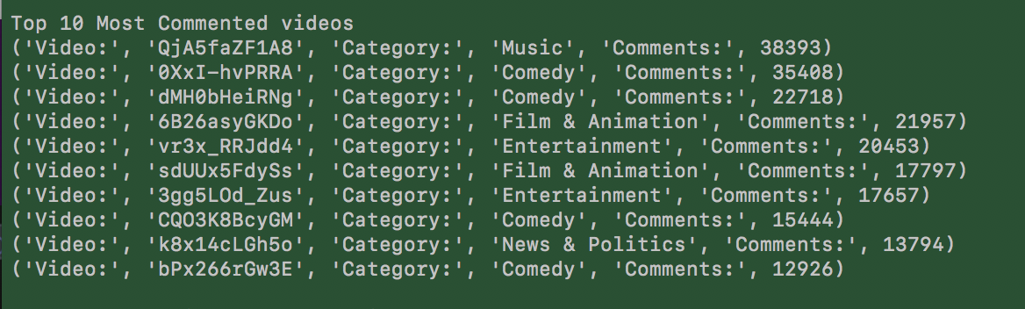
Use Case 5 - Top Highly commented Videos
Steps:
For each row, map: (dataset) -> (video id, number of comments)
Sort by number of comments.
Implementation to the left includes the category in the tuple, but it is not necessary for the analysis.

Slide 17
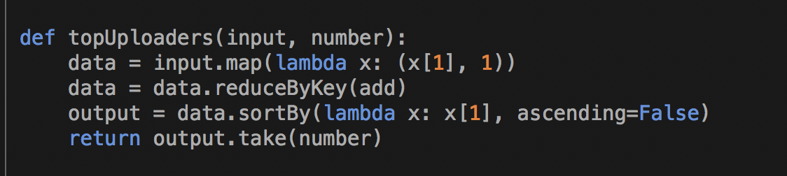
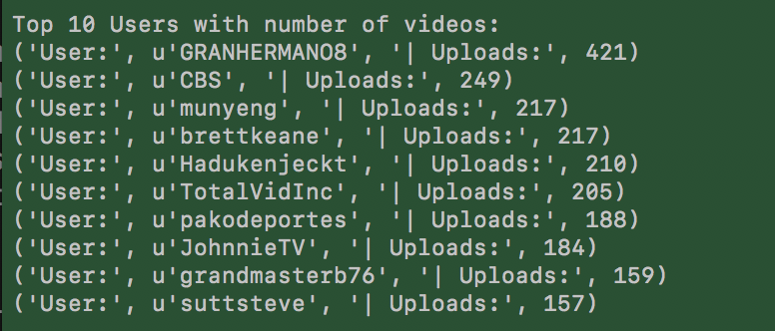
Use Case 6 - Top Video Uploaders
Steps:
For each row, map: (dataset) -> (username, 1)
For each tuple, reduce by adding: (username, 1) -> (username, total number of videos)

Slide 18




Tools and software
This project relies on the following tools:

Slide 19
Demo

Slide 20
Questions?

